Slide 1
Automated Dependency Updates in Azure DevOps
who wouldn't want that?
Ivo Verburgh
Lead .NET Developer
4Dotnet pizzasessies juni 2025
June 5th 2025

Slide 2



Ivo Verburgh
Lead .NET Developer
Software development:
Kaizen/Lean/Agile/Scrum/DevOps
Code Quality (TDD, Refactoring)
Architecture/Design Patterns
CI (Static Code Analysis) / CD (IAC)
Azure DevOps
Hobby’s:
Sailing
CrossFit
Running
Scouting
Geocaching
https://www.linkedin.com/in/ivo-verburgh/
https://github.com/iverburgh/

Slide 3
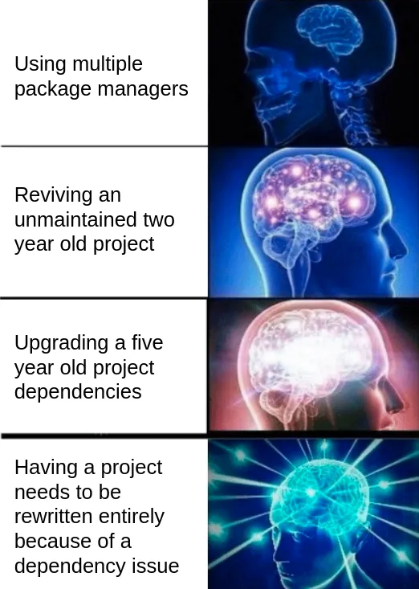

Slide 4



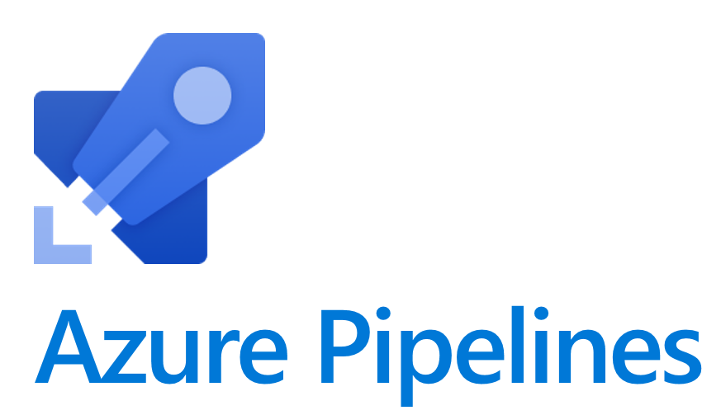
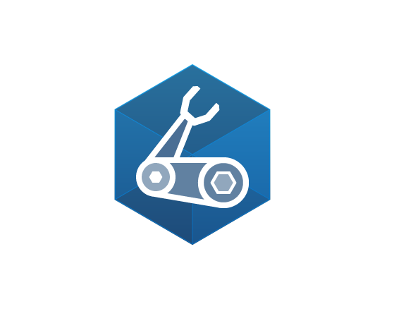

Slide 5
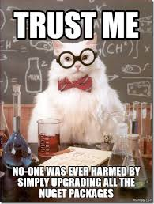

Slide 6


Slide 7


Slide 8


Slide 9
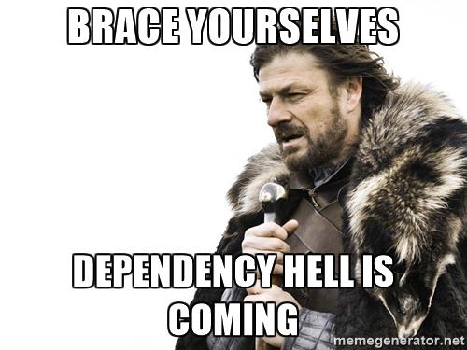

Slide 10
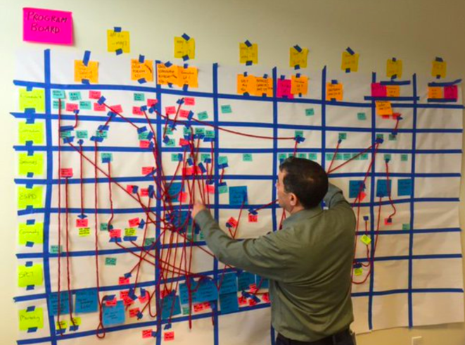

Slide 11
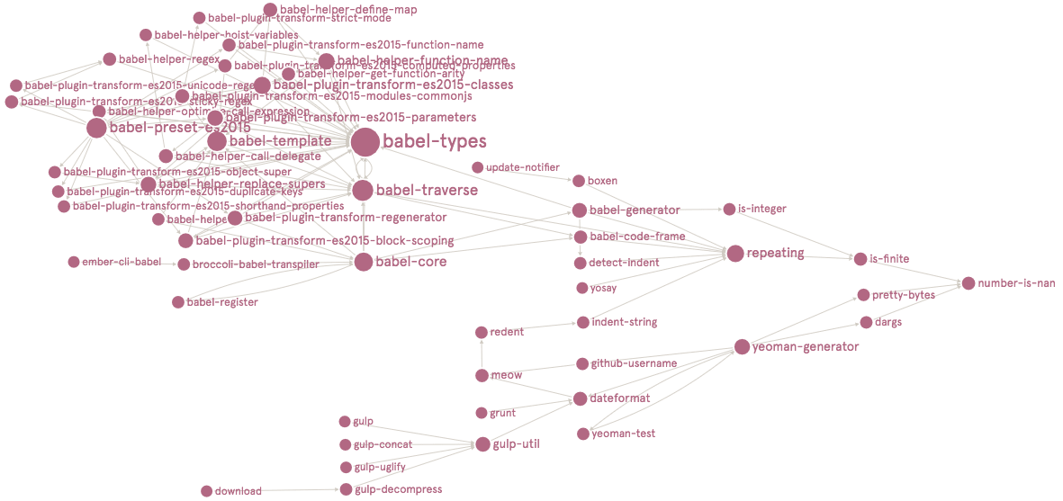

Slide 12
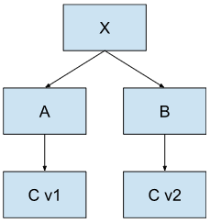

Slide 13
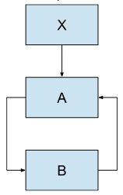

Slide 14
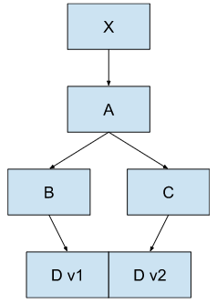

Slide 15
“It’s much easier to apply a patch when it’s really critical if you’re closer to the latest version,”

Slide 16
“Small software changes are easier than big software changes. If you’re constantly updating your dependencies, you can handle those changes over time rather than having them all at once.”
Maya Kaczorowski
senior director of product management and software supply chain security at GitHub

Slide 17


Slide 18


Slide 19
Tool / Feature | .NET SDK | NuGet | Node | NPM | Bicep | AzDo YAML Task
Dependabot for Azure DevOps (Tingle Software) | ✅ Yes | ✅ Yes | ❌ No | ✅ Yes | ❌ No | ❌ No
Renovate | ✅ Yes | ✅ Yes | ✅ Yes | ✅ Yes | ⚠️ Partial | ✅ Yes
NuKeeper (Deprecated) | ❌ No | ✅ Yes | ❌ No | ❌ No | ❌ No | ❌ No
dotnet-outdated | ❌ No | ✅ Yes | ❌ No | ❌ No | ❌ No | ❌ No
NDepend | ❌ No | ✅ Yes | ❌ No | ❌ No | ❌ No | ❌ No
ProGet | ❌ No | ✅ Yes | ❌ No | ✅ Yes | ❌ No | ❌ No
Greenkeeper (deprecated) | ❌ No | ❌ No | ❌ No | ✅ Yes | ❌ No | ❌ No
Snyk | ❌ No | ✅ Yes | ❌ No | ✅ Yes | ⚠️ Partial | ❌ No

Slide 20
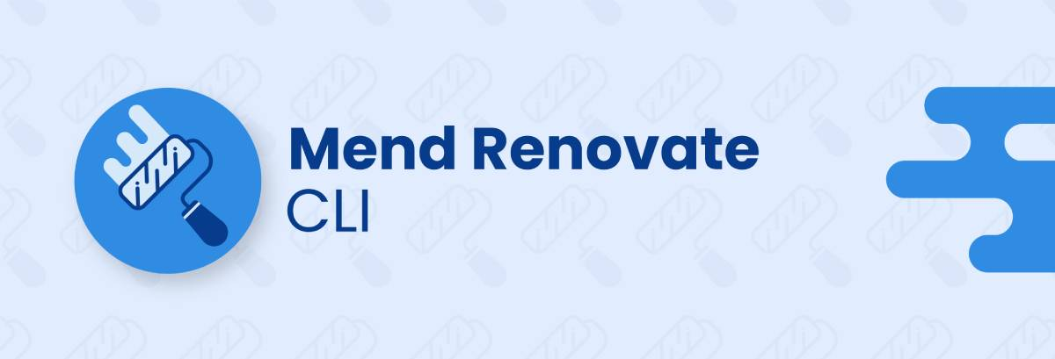

Slide 21
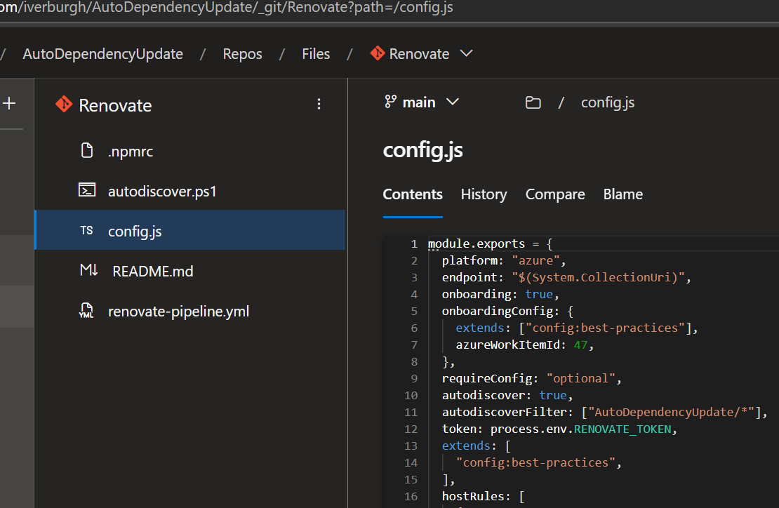

Slide 22
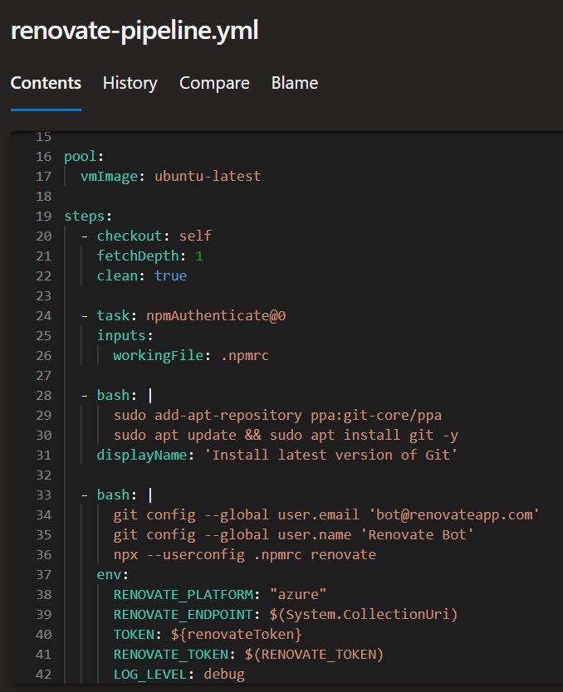

Slide 23
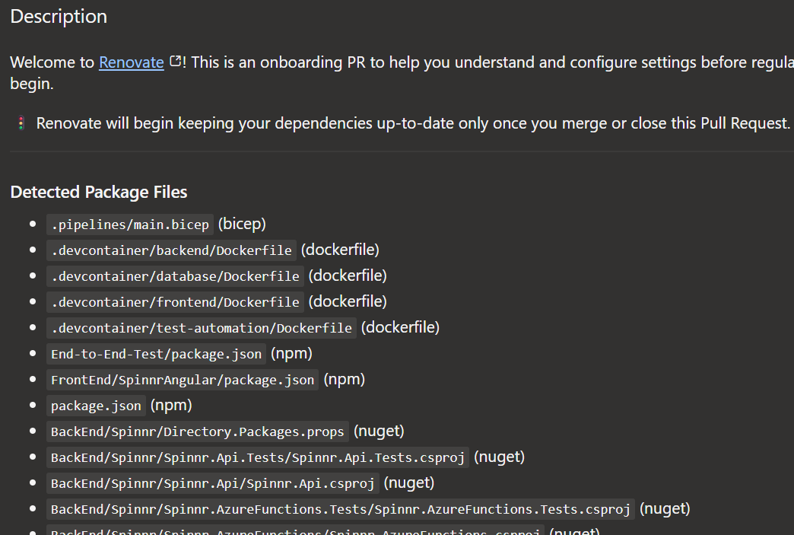

Slide 24
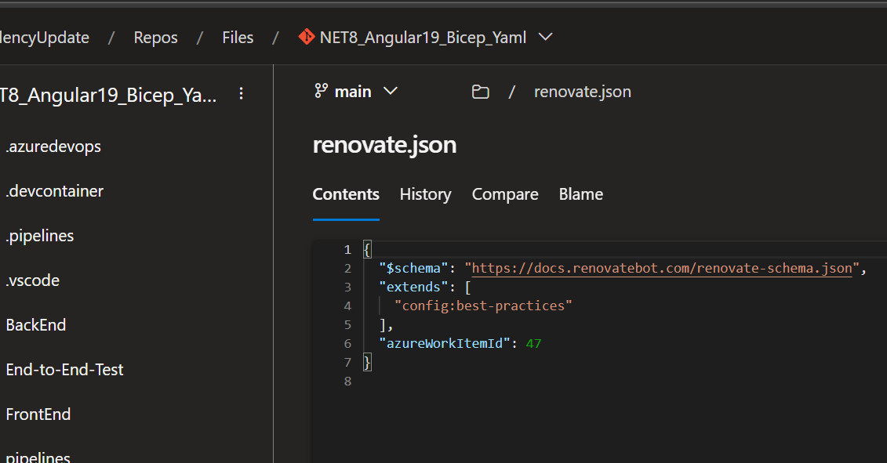

Slide 25
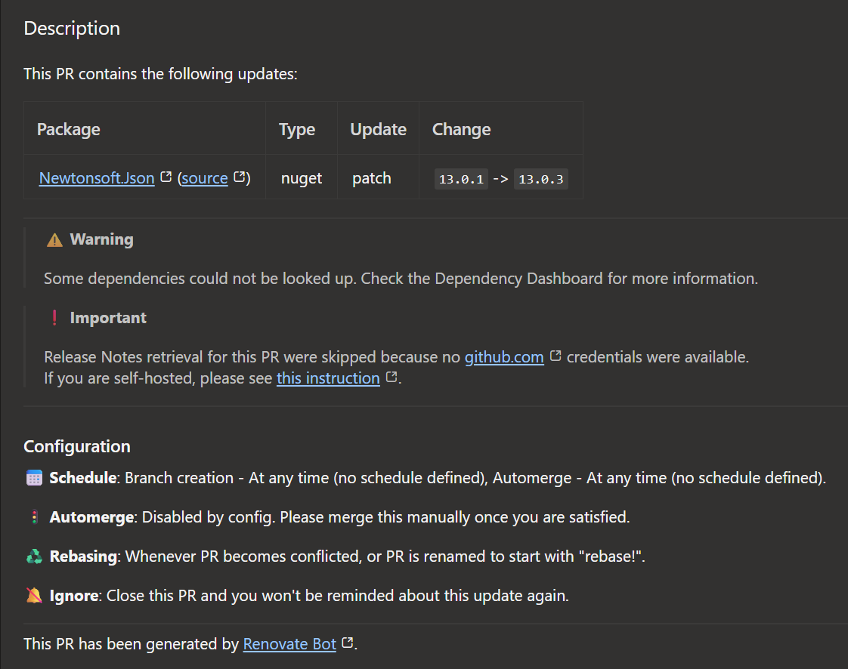

Slide 26
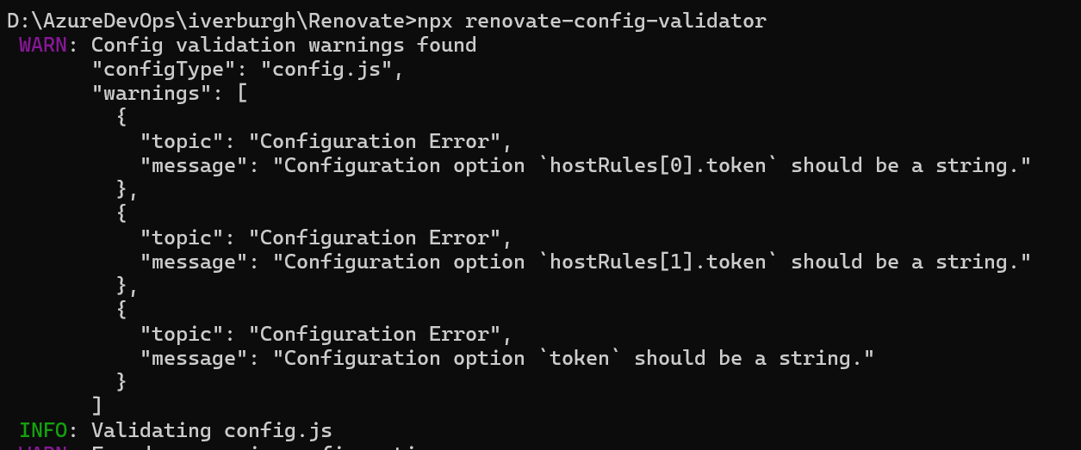

Slide 27
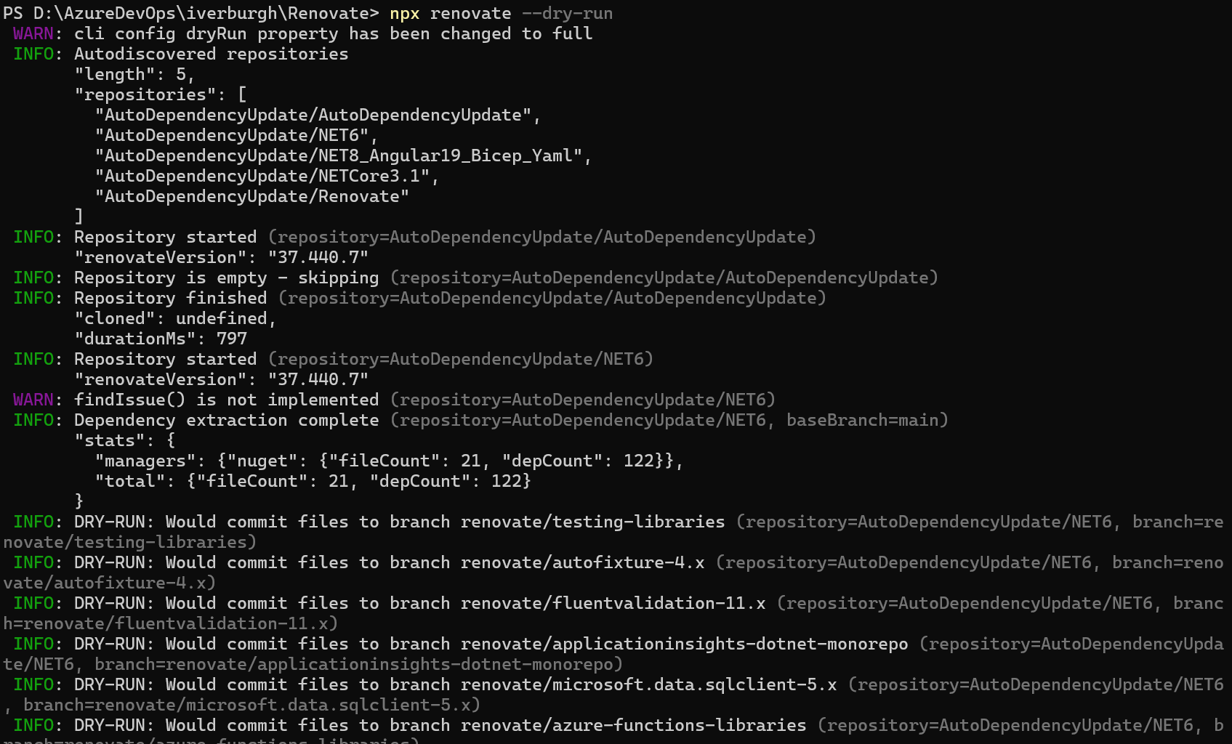

Slide 28
Ivo Verburgh
Lead .NET Developer
https://github.com/iverburgh/
https://www.linkedin.com/in/ivo-verburgh/

